Slide 1
Software Architecture

Slide 2
Learning Outcomes
By the end of this lesson, you should be able to:
Understand why software architecture is important
Understand how Agile works with software architecture
Understand and apply the C4 model to your individual and group projects
Understand and apply the principles of Sequence Diagrams
Apply these principles in the software architecture document
Notes:
Why Software Architecture?
Architecture in Agile
C4 Model
Software Architecture Document

Slide 3
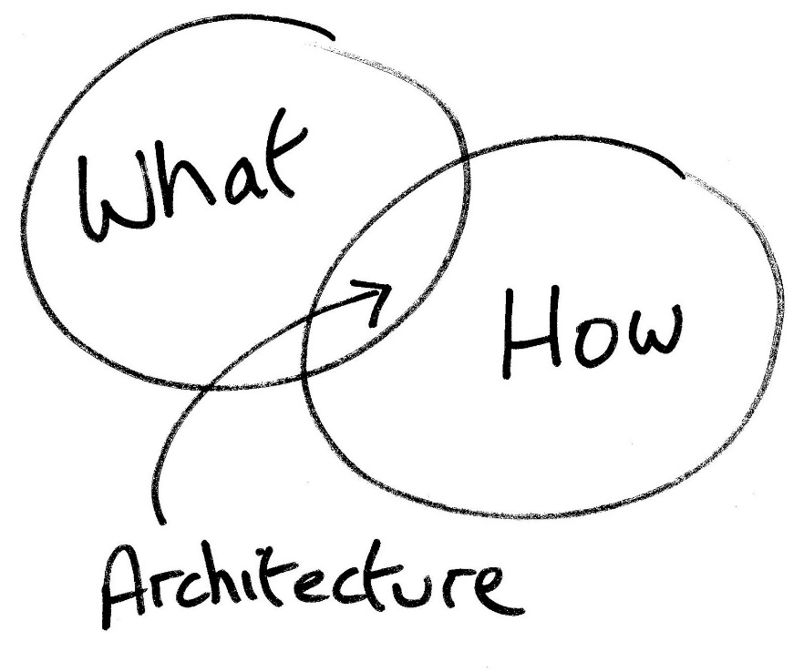
Why software architecture?
Gives a direction to developers
Guaranteeing Functional and Non-Functional Requirements
Analysing and constraining risks
Document decisions
Maintenance docs

Slide 4
C4 Model

Slide 5
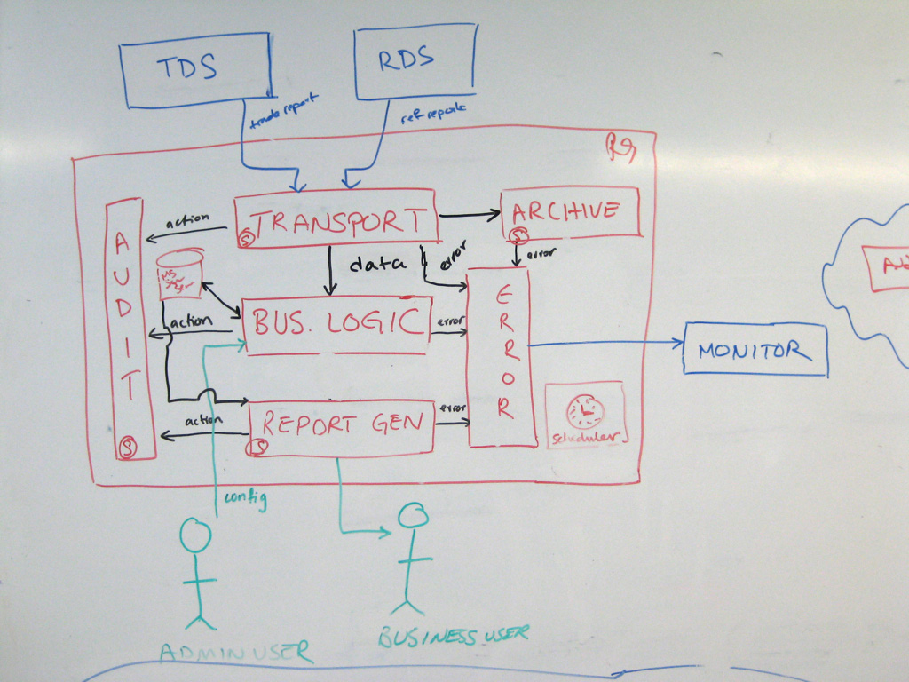
What if I ask you to explain your software architecture using diagrams?
Notes:
https://c4model.com
Ask a software developer to communicate the software architecture of a software system using diagrams and you'll likely get a confused mess of boxes and lines ... inconsistent notation (colour coding, shapes, line styles, etc), ambiguous naming, unlabelled relationships, generic terminology, missing technology choices, mixed abstractions, etc.

Slide 6
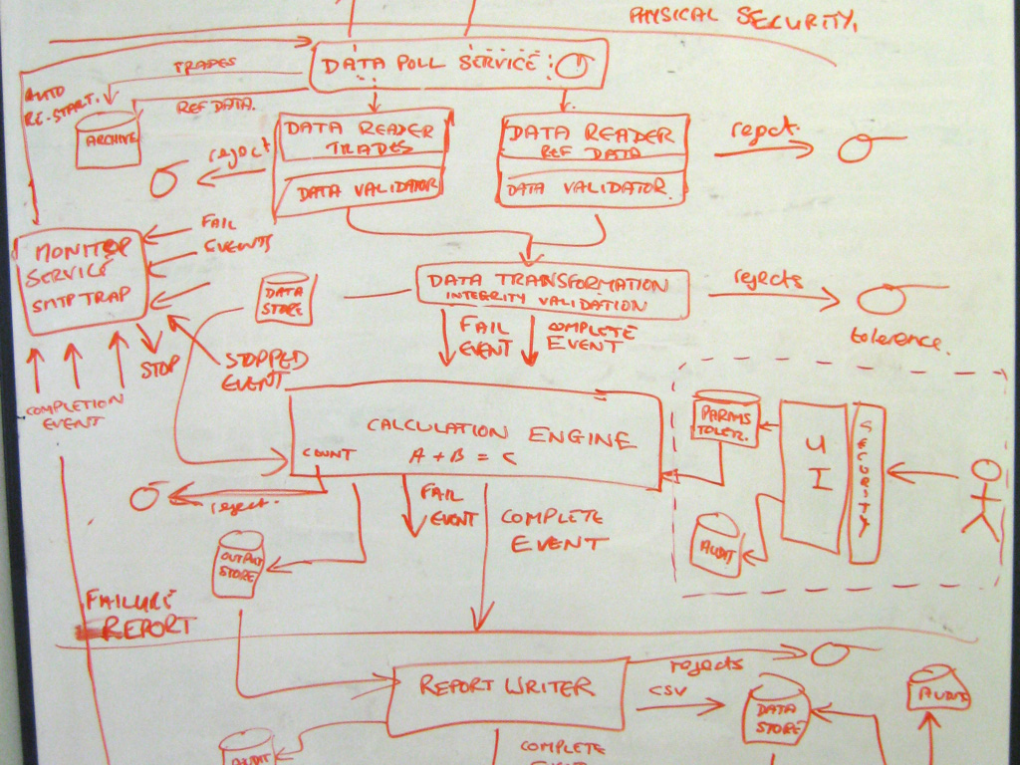
What if I ask you to explain your software architecture using diagrams?
Notes:
https://c4model.com
Another example of boxes and lines, also from c4model.com

Slide 7
What we expect from you this sprint
Start with a simple 3 tier architectural design
FE + BE + DB
Make a Walking Skeleton and add to it
To communicate your architectural design use the C4 model diagrams: https://c4model.com

Slide 8
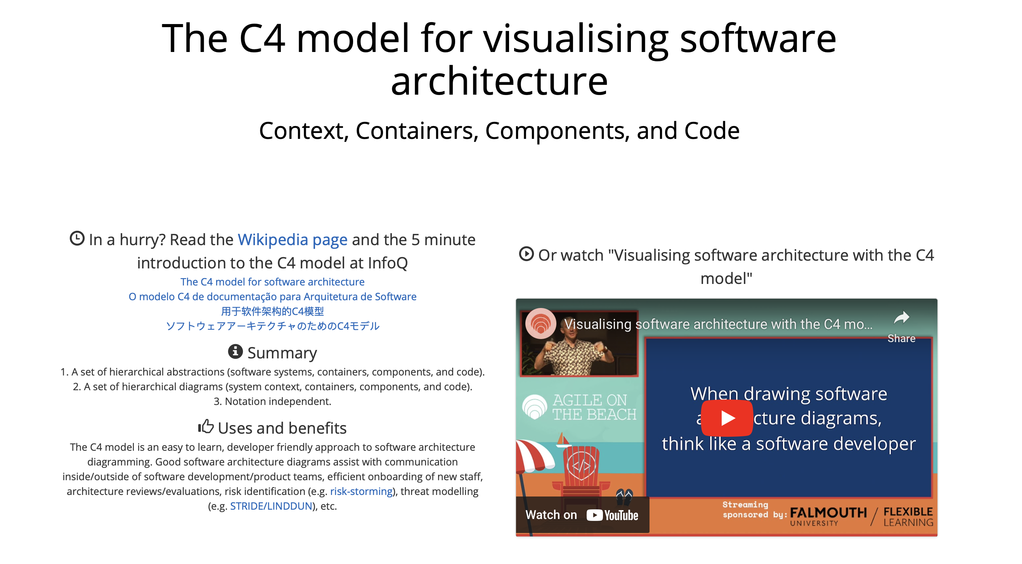
https://c4model.com

Slide 9
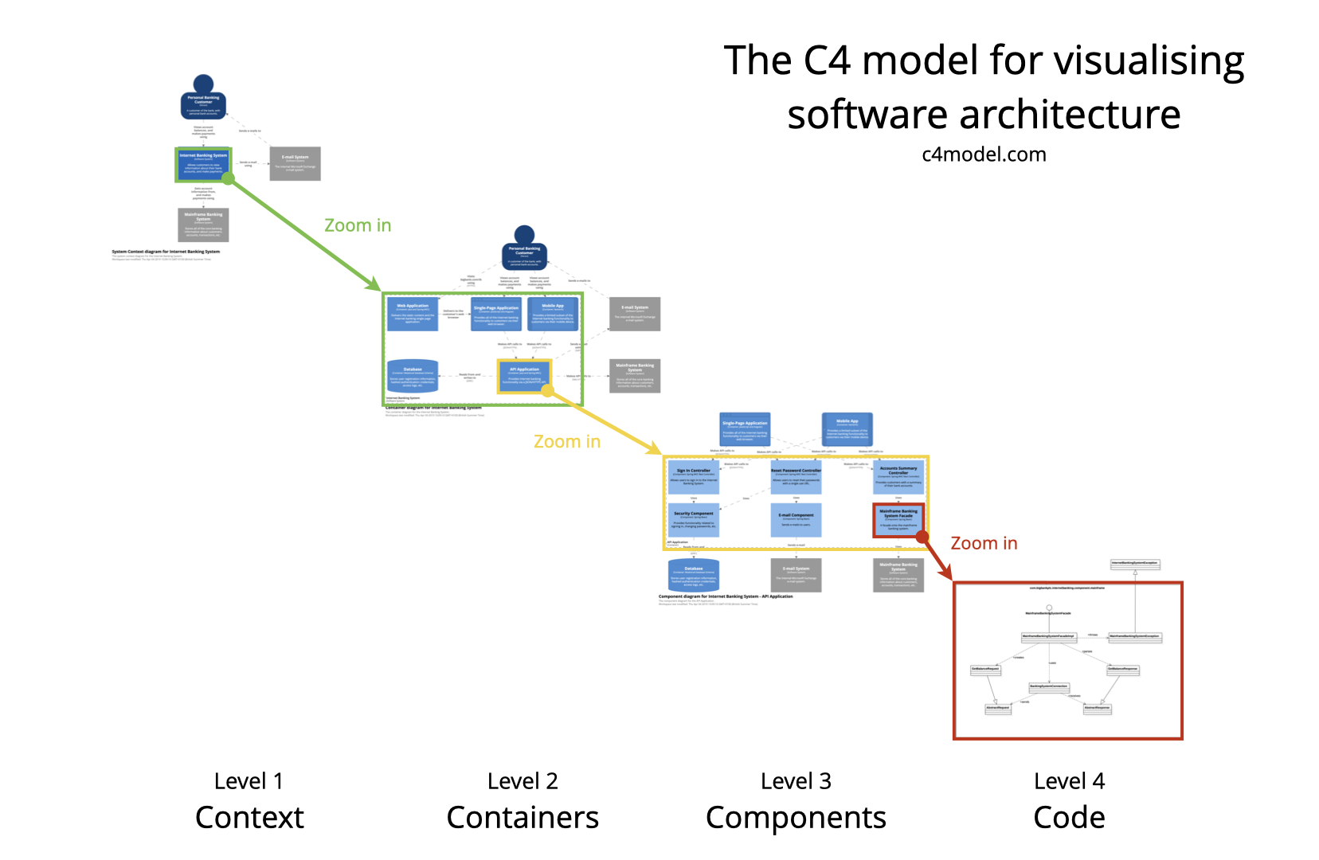
The C4 model
Notes:
Agree on a simple set of abstractions that the whole team can use to communicate. We prefer UML at Fontys.
Draw a number of simple diagrams at different levels of abstraction
System context
Container diagram
Component diagram
Class diagram
(See next slide)

Slide 10
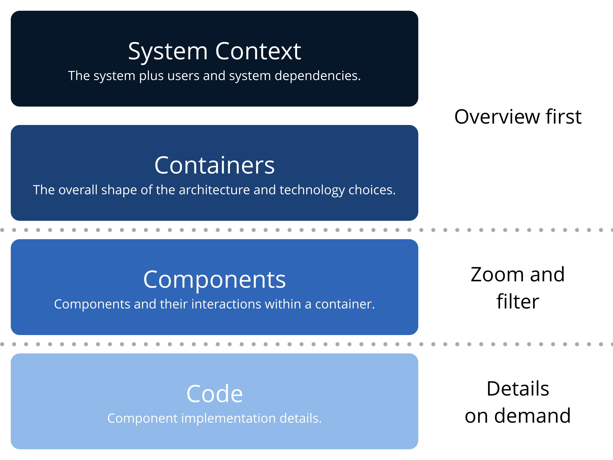

Slide 11
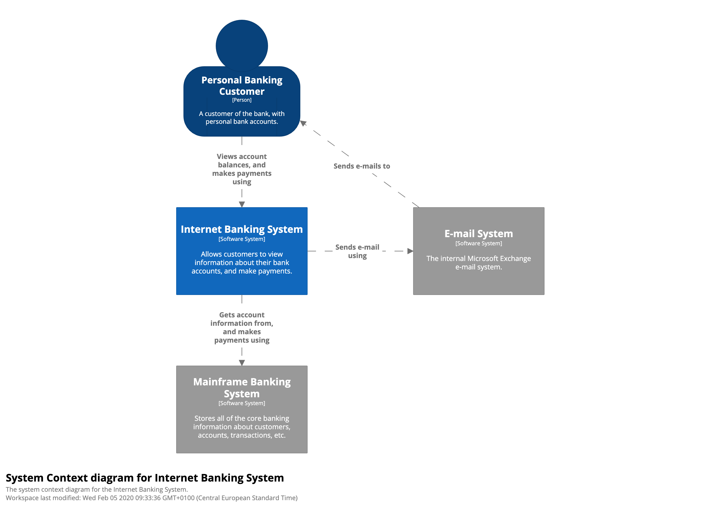
System Context (C1) System, users, dependencies
Notes:
https://leanpub.com/visualising-software-architecture/read#context
System Context: A System Context diagram provides a starting point, showing how the software system in scope fits into the world around it.

Slide 12
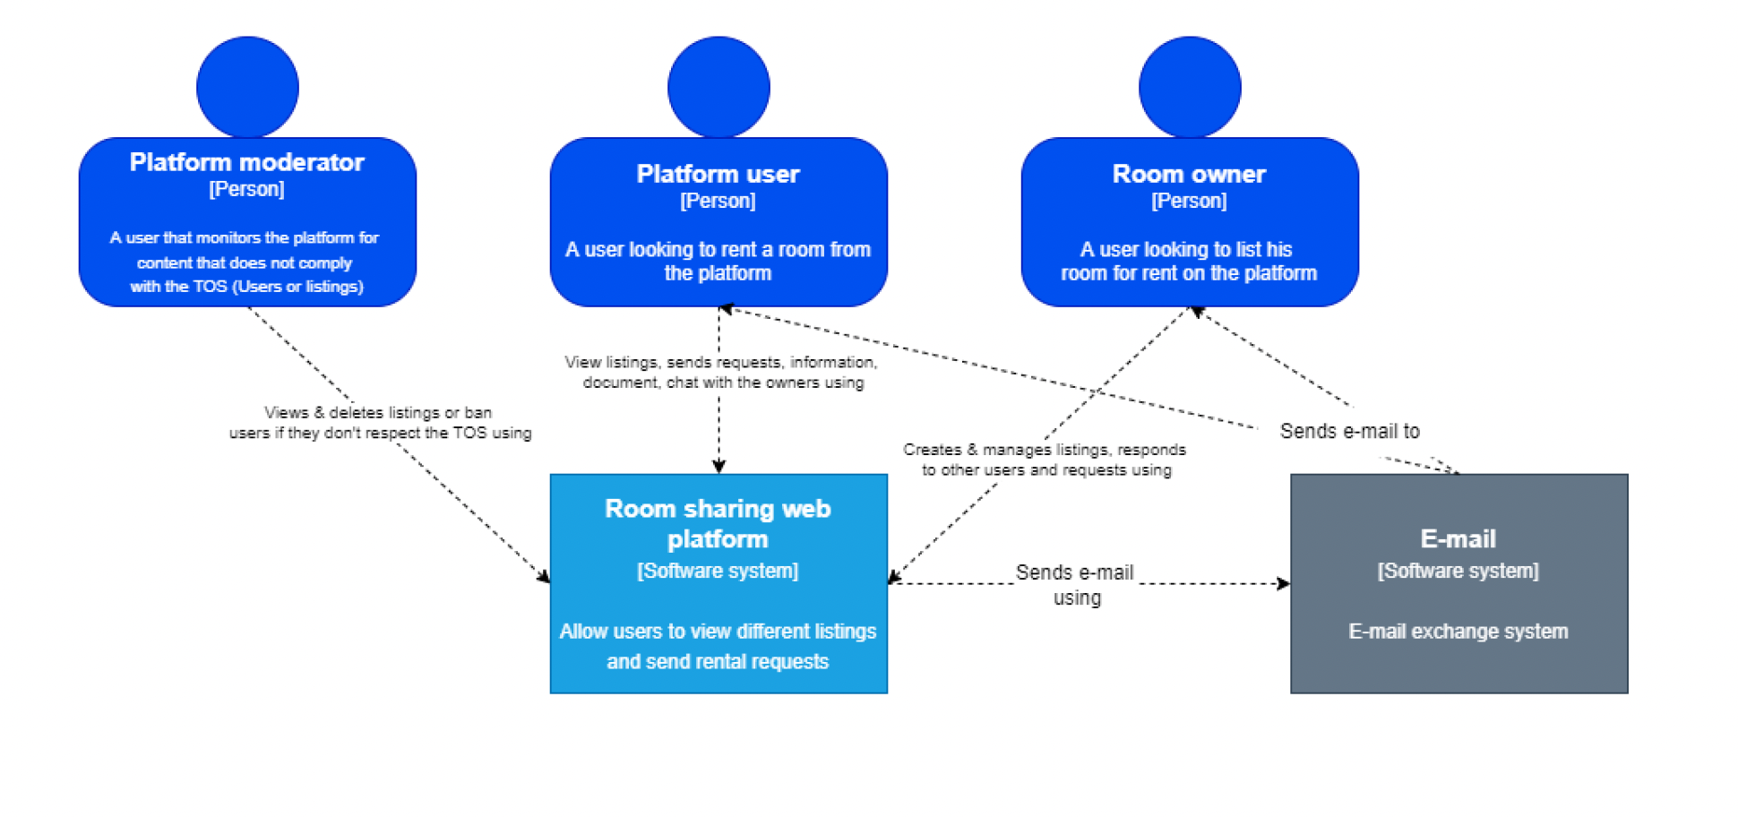
C1: Another Example

Slide 13
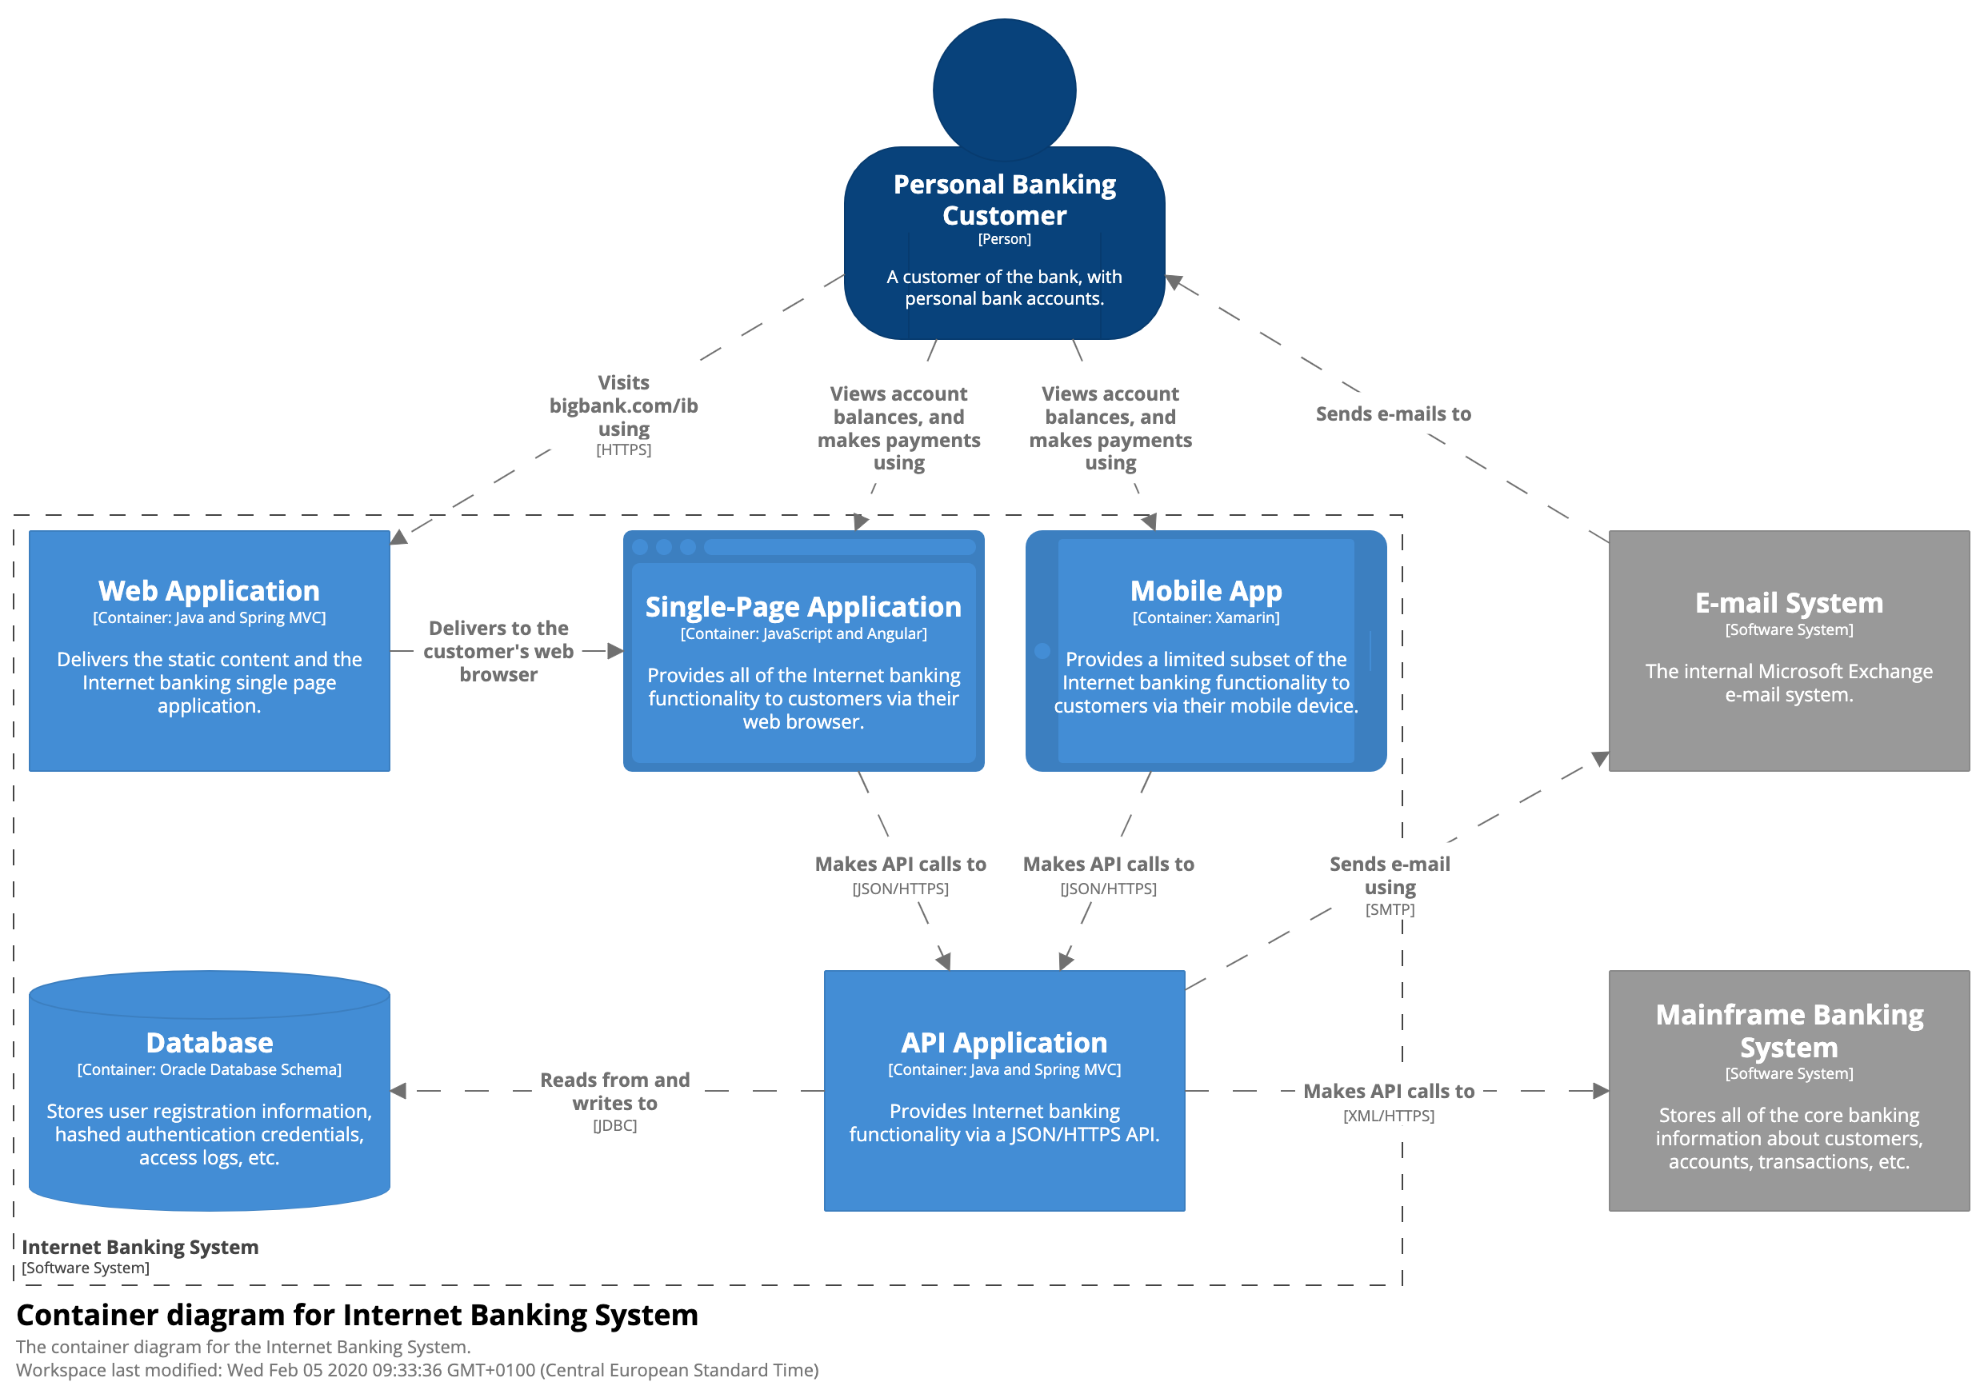
Containers (C2) Overall shape Technology choices
C2 contains containers that should be able to run independently.
It also shows how the containers interact with users or systems outside the application.
Notes:
https://leanpub.com/visualising-software-architecture/read#context
Containers: A Container diagram zooms into the software system in scope, showing the high-level technical building blocks (containers) and how they interact.
C2 contains containers that should be able to run independently. It also shows how the containers interact with users or systems outside the application.

Slide 14
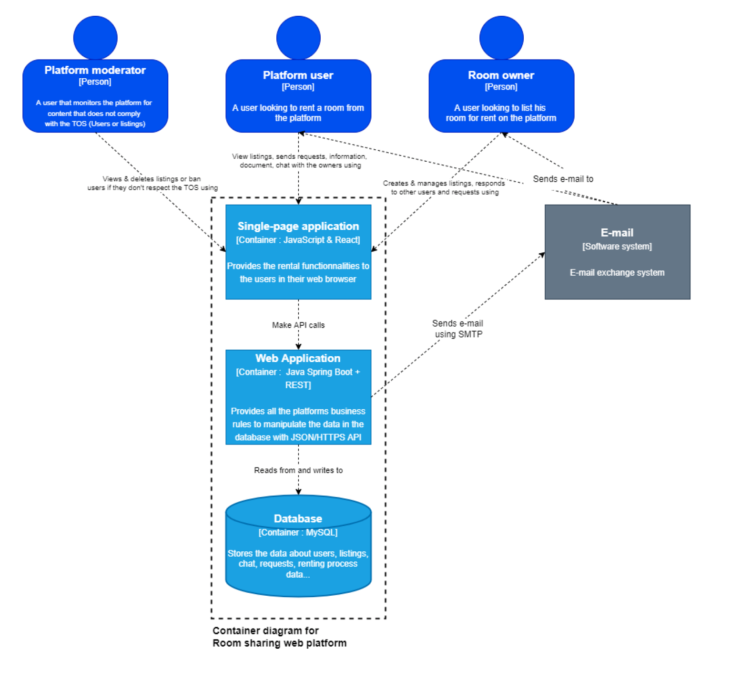
C2: Another Example

Slide 15
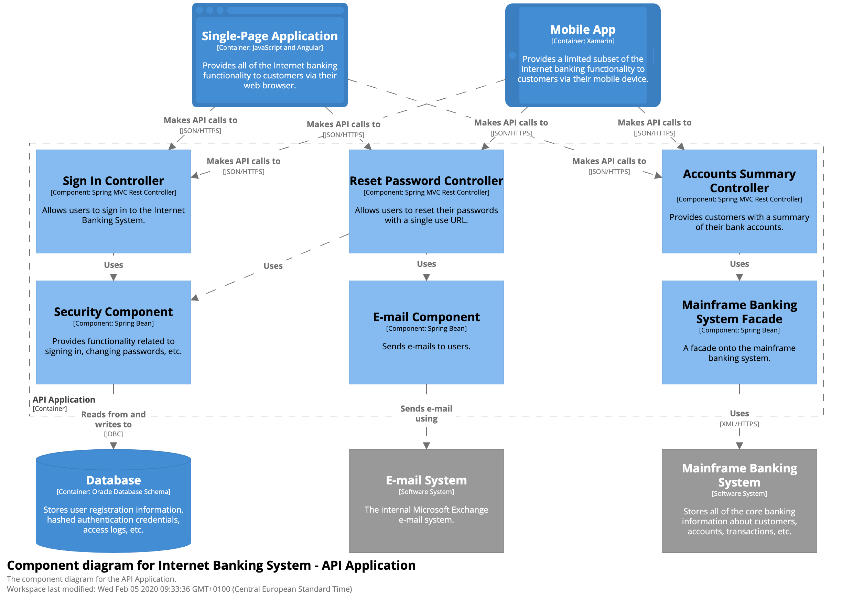
Components (C3) Components and their interactions
Notes:
https://leanpub.com/visualising-software-architecture/read#context
Components: A Component diagram zooms into an individual container, showing the components inside it.

Slide 16
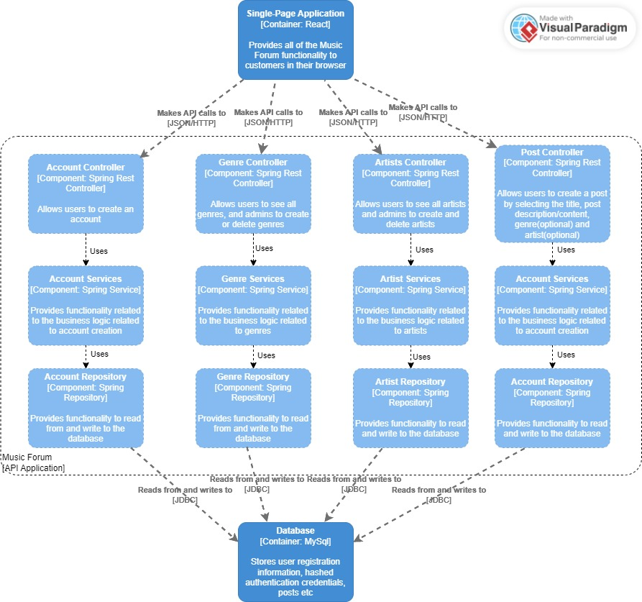
C3: Another Example

Slide 17
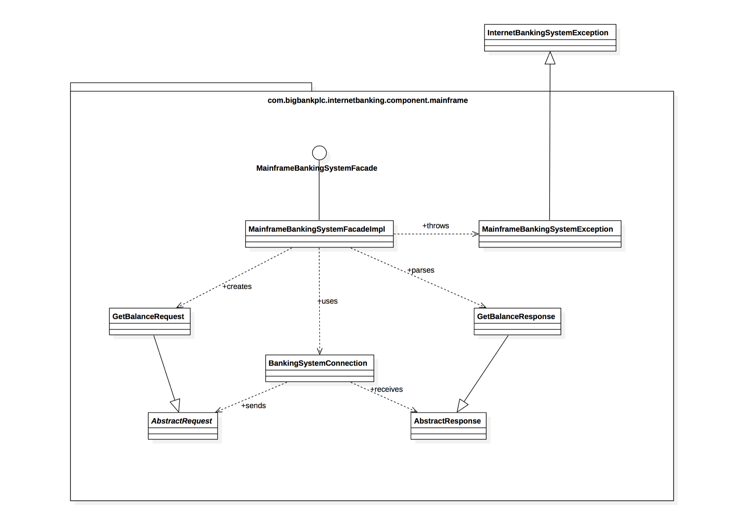
Code (C4) Implementation details
Notes:
https://leanpub.com/visualising-software-architecture/read#context
Code: A code (e.g. UML class) diagram can be used to zoom into an individual component, showing how that component is implemented.

Slide 18
Tooling to draw your C4 and UML diagrams
Draw.io with plugin for C4 (or online)
Structurizr for C4 diagrams: structurizr.org
Visual Paradigm for UML diagrams:
visual-paradigm.com
Licence key from Studentenplein: licence key
C4-PlantUML
https://github.com/plantuml-stdlib/C4-PlantUML

Slide 19
Sequence Diagrams
Notes:
The idea is to give some initial directions for students on sequence diagrams, and not to explain everything in details. They should do research and learn by themselves (some references in the first slide from this topic).

Slide 20
Sequence Diagram
Are interaction diagrams showing how operations are carried out in the application
Show the interaction of objects and their communication (messages exchanged)
It focus on living objects running in memory
Focus on the time and order of interaction
Notes:
Some references:
https://www.lucidchart.com/pages/uml-sequence-diagram
https://www.visual-paradigm.com/guide/uml-unified-modeling-language/what-is-sequence-diagram/

Slide 21
Sequence Diagram
Let’s use the following known user story:
As a user, I want to be able to create a student so that I can manage them in the system
Notes:
We will use the Create Student user story, this is example is known from the students from the demos (specially from the REST one).

Slide 22
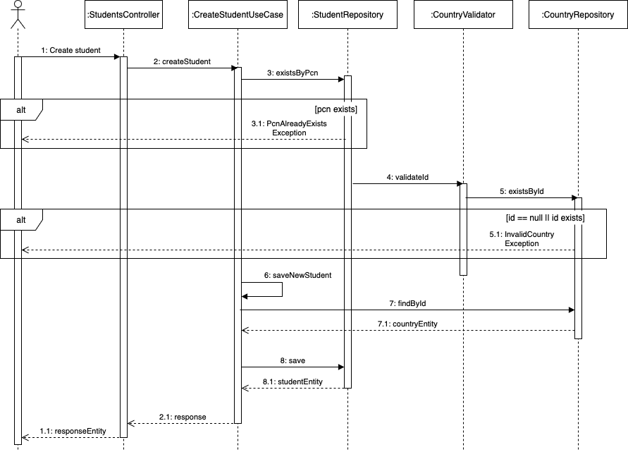
Sequence Diagram
Lifeline
Call message
Activation
Alternative
Self Message
Return message

Slide 23
Software Architecture Document

Slide 24
Software Architecture Document (SAD)
Don’t forget to justify your choices
Content:
Introduction
System Context (C1)
Containers and tech choices (C2)
Components (C3)
Class diagrams and sequence diagrams
A very good source for info: https://c4model.com
Notes:
Remember: we expect diagrams with contextual explanations.

